Slide 1
Parking Garage Project Presentation - Project.init()
By Vishal, Kurt, Raymond, and Chris

Slide 2
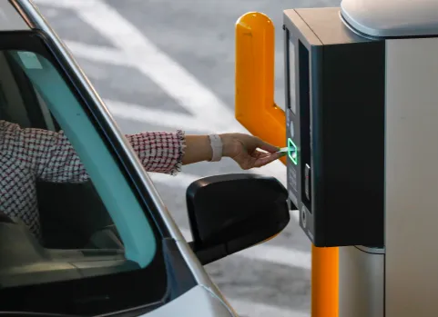
Topic Description
Parking garage will:
Allow customers to enter and park for a fee.
Charge customers upon leaving the garage based on the duration of their stay.
Track available parking spaces and display dynamically.
Use GUI for client side app and send requests to server side app.
Notes:
Parking garage will provide a count of available parking spots
check in a vehicle to occupy an available parking spot
track the time that the vehicle occupies its given spot
charge customers based on the garages parking rates.

Slide 3
Requirement 1: Payment Method
Ticket given at entry for occupying a parking space must be given at checkout.
The accepted payment methods include:
Debit cards
Credit Cards
Cash
Self-pay parking kiosk will allow customers to pay for parking via credit or debit cards
Paying in and out of the parking garage, employees will also be processing payment as well as the automated systems.

Slide 4
Requirement 2: Parking Duration
Tracking the duration of a parked car should be measured and stored for quick retrieval during payment calculation.
Notes:
A reservation system is utilized to track the time a vehicle occupies
A parking spot.
At time of arrival, the system will check if the garage is not full. If so, a reservation is placed:
Set an available parking spot to occupied
Set the starting time
Also, will have end time that will be given at the end of the reservation or check out.
The reservation will also be for the ticket.

Slide 5
Requirement 3: Parking Space Tracking
The system should keep track of available parking spaces and number of customers waiting to determine allocation of parking and availability for pending clients.

Slide 6
Requirement 4: Concurrent Client Handling
The system must support handling multiple clients simultaneously, allowing several vehicles to enter, pay, and exit the parking facility without delays or system crashes.
Proper synchronization mechanisms should be implemented to avoid data mixups or other issues.

Slide 7
Requirement 5: Graphical User Interface
The system must provide a GUI for both customers and employees
The GUI must display parking availability, fee details, and payment options.
The Client Side Application need to implement the GUI.

Slide 8
Requirement 6: Employee Login
Employees must log in with a username and password.
System must validate if employees use unique ID and password to login.
Only authorized employees can process payments and access usage reports.

Slide 9

Requirement 7: Usage Report for Management
The system must generate daily, weekly, and monthly usage reports.
total revenue
peak times
space utilization.
Monitor
Performance and errors.
Number of users who prefer system without manual assistance.
Notes:
We will keep track daily of the facilities transaction, allowing us to record revenue and the peak times.
Electric Vehicle charging stations would also be integrated within each of our parking facilities.
May not record usage, but track sales daily.

Slide 10
Requirement 8: Multi-Garage Management
The server must support managing multiple parking garages, allowing independent tracking of parking availability, payments, and vehicle logs for each location.
Each parking garage should have its own set of data (e.g., capacity, payment records, customer entries/exits), while still allowing the central server to coordinate and synchronize operations across all garages.
The system should provide a user interface that allows employees to view and manage data from all garages in real-time, ensuring efficient operations.
Notes:
Recorded parking duration by (either ticket given at entry or vehicle’s license plate recognition)
Payment processing will be synchronized with system to adhere to the space occupancy (all kiosk).
A user interface

Slide 11

Requirement 9: Error Handling
The system should detect and handle any failed attempts/request or connection issues.
This includes failed attempts at issuing tickets, accessing real-time data of garages, and payment processing.
Notes:
Lighting, surveillance and security guards

Slide 12
Requirement 10: Response Time
The system must provide real-time processing including parking entry, exit, fee calculation, and payment processing.
Updates to parking availability and transaction data must be presented to clients with minimal delay.
The system must maintain responsive performance under normal and peak load conditions.

Slide 13


Slide 14


